Slide 1

wiStA
Twitter Sentiment Analysis

Slide 2



SPARQL Query
Software Architecture
Linked Open Service
Twitter4J (Twitter for Java API)
RDF
Sentiment Analysis Stanford NLP
JENA
RDF Repository
SPARQL
SELECT ?sentiment :obtained ?topic,
WHERE{
?sentiment :sentFoundIn ?tweet.
?tweet :date ?date.
?tweet :topic ?topic}
Politics Evolutional Timeline Sentiment Analysis
Keyword / HashTag: #Obama
IN
Statistical Histogram
OUT

Slide 3
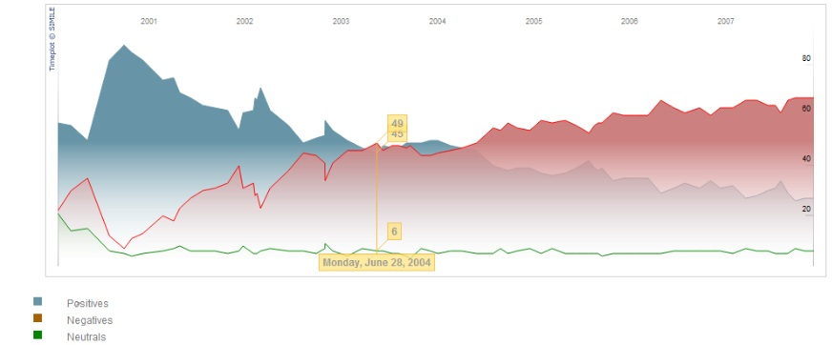
Politics Evolutional Timeline Sentiment Analysis
IN
Keyword / HashTag: #Obama
Statistical Histogram
OUT

Slide 4
Sentiment
:SentimentType
:SentimentType
:SentimentType
PositiveSentiment
NegativeSentiment
NeutralSentiment
:foundIn
:foundIn
:foundIn
Tweet about Obama
Tweet about Mundial Crisis
Tweet about London riots

